Slide 1
Machine Learning | End to End Project using Python and Jupyter notebook
Predict ‘how many medals a country will win at the Olympics’ by using historical data.

Slide 2

1.Hypothesis
We will predict ‘How many medals a country will win in the Olympics.

Slide 3
2.Find a Data
team | year | athletes | prev_medals | medals
USA | 2008 | 763 | 263 | 317
USA | 2012 | 689 | 317 | 248
USA | 2016 | 719 | 248 | 264
IND | 2008 | 67 | 1 | 3
IND | 2012 | 95 | 3 | 6
IND | 2016 | 130 | 6 | 2
We're using data from the Summer Olympics, with each row representing a country in a specific Olympic year. Columns include
Team: Three-letter code for the country.
Year: The year of the Olympics.
Athletes: Number of athletes from the country.
Previous Medals: Medals won in the prior Olympics (e.g., 2008 row shows medals from 2004).
Medals (Target): The number of medals the team won in the current Olympics.
▪ For example, Team USA in 2008 won 317 Olympic medals.

Slide 4
3.Reshape the Data
team | year | athletes | prev_medals | medals
USA | 2008 | 763 | 263 | 317
USA | 2012 | 689 | 317 | 248
USA | 2016 | 719 | 248 | 264
IND | 2008 | 67 | 1 | 3
IND | 2012 | 95 | 3 | 6
IND | 2016 | 130 | 6 | 2
For our machine learning predictions, we'll use the "athletes" and "prev_medals" columns to predict the "medals" column. Fortunately, our data is already structured for this purpose, with all necessary information available in a single row. We won't need extensive reshaping since the target column and predictor columns are readily accessible within each row. This enables us to effectively predict the number of medals a team will win in a given year.
Notes:
a

Slide 5
4.Clean the Data
team | year | athletes | prev_medals | medals
ALB | 1992 | 9 | - | 0
ALG | 1964 | 7 | - | 0
AND | 1976 | 3 | - | 0
BLR | 1996 | 259 | - | 23
ARM | 1996 | 38 | - | 2
Cleaning our data involves addressing missing values, which are common in our dataset. For instance, in the "prev_medals" column, some entries are missing because certain countries did not participate in the previous Olympics. This absence of data poses a challenge as most machine learning algorithms cannot handle missing values. Therefore, our next step is to clean the data by handling these missing values appropriately.

Slide 6
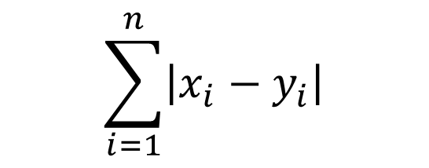
5.Error Metric
team | year | medals | predictions
ALB | 1992 | 0 | 3
ALG | 1964 | 0 | 2
AND | 1976 | 0 | 2
BLR | 1996 | 23 | 15
ARM | 1996 | 2 | 5
$$\sum_{i=1}^{n}{\left|x_{i}−y_{i}\right|}$$
In the fifth step, we'll focus on selecting an error metric to assess the performance of our machine learning model. As our model generates predictions for the number of medals a country should have earned in a specific Olympics, we must compare these predictions with the actual medal counts to determine their accuracy. An error metric provides a quantitative measure of how well our predictions align with the ground truth data, allowing us to evaluate the effectiveness of our model.

